Slide 1



UNIVERSITY INSTITUTE OF ENGINEERING
COMPUTER SCIENCE ENGINEERING
Bachelor of Engineering
Design and Analysis of Algorithms(CST-311/ITT-311)
Topic: Longest common Subsequence
DISCOVER . LEARN . EMPOWER

Slide 2
Learning Objectives & Outcomes
Objective:
To understand the concept of Longest common Subsequence using dynamic programming
Outcome:
Student will understand
Find the Longest common Subsequence using dynamic programming

Slide 3
Longest common Subsequence
If a set of sequences are given, the longest common subsequence problem is to find a common subsequence of all the sequences that is of maximal length.
The longest common subsequence problem is a classic computer science problem, the basis of data comparison programs such as the diff-utility, and has applications in bioinformatics. It is also widely used by revision control systems, such as SVN and Git, for reconciling multiple changes made to a revision-controlled collection of files.

Slide 4
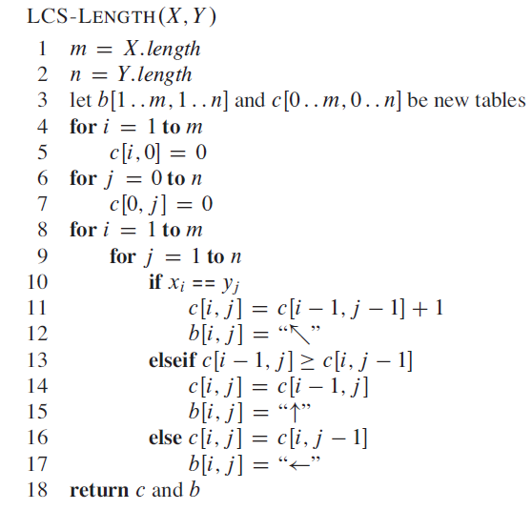
Algorithm of Longest Common Sequence

Slide 5
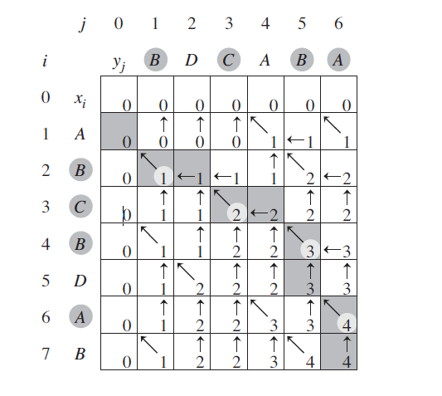
Example 1
LCS-LENGTH on the sequences:
X: A,B,C,B,D,A,B and
Y: B,D,C,A,B,A

Slide 6
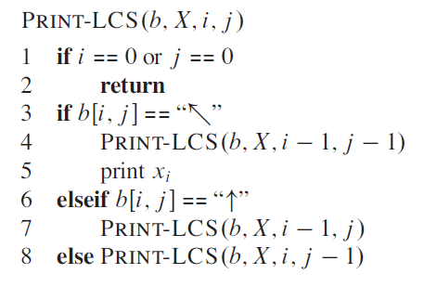
Algorithm for printing LCS
This procedure prints BCBA (for given example 1)

Slide 7
REFERENCES
Text books:
Cormen, Leiserson, Rivest, Stein, “Introduction to Algorithms”, Prentice Hall of India, 3rd edition 2012. problem, Graph coloring.
Websites:
https://www.javatpoint.com/longest-common-sequence-algorithm
https://www.tutorialspoint.com/design_and_analysis_of_algorithms/design_and_analysis_of_algorithms_longest_common_subsequence.htm

Slide 8
Summary
  Dynamic programming:
    Longest Common Subsequence

Slide 9
THANK YOU

